Slide 1
Procedural skies
Advanced Graphics Programming

Slide 2
Atmospheric effects difficult to recreate
The sky is not a solid object
A priori, we cannot render a surface and decide each pixel color
The atmosphere is a set of layers of gases surrounding a planet

Slide 3
Atmospheric scattering phenomenon
Discovery attributed to Rayleigh (late 29th century)
Computer graphics
Nishita 1993, 1996 (volumetric rendering)
Preetham 1999 (analytical model)
Jensen 2011 (night sky model)

Slide 4
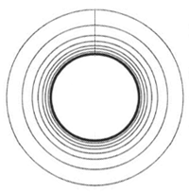

Common assumption:
Atmosphere density decreases exponentially with height
H is the scale height (the atmosphere thickness)
Another approach is modeling the sky densities as a series of layers

Slide 5
Rayleigh scattering
Scattering of light by air molecules (small molecules)
Mie scattering
Scattering of light by aerosol (big molecules)

Slide 6

Rayleigh scattering
Scattering coefficient at height h for wavelength lambda:
N: molecular density at sea level
n: index of refraction (IOR) of air
H_{R}: scale height (atmosphere thickness, we use 8km)

Slide 7
Rayleigh scattering
Precomputed scattering coefficients at sea level for RGB peak wavelengths:
Red (680 nm): 3.8 e⁻⁶ m⁻¹
Green (550 nm): 13.5 e⁻⁶ m⁻¹
Blue (440 nm): 33.1 e⁻⁶ m⁻¹
By just applying the exponential part of the equation (the right term) we can adjust these coefficients for any given altitude h.
Extinction coefficient = Scattering coefficient (absorption coefficient is zero)

Slide 8

Mie scattering
Scattering coefficient at height h for wavelength lambda:
First term is the Mie scattering at sea level
Not modeled by any equation
Values are taken from measurements at sea level
Common value: 210 e⁻⁵ m⁻¹
H_{M}: scale height (aerosols layer thickness, we use 1.2km)
Extinction coefficient = Scattering coefficient + absorption coefficient

Slide 9

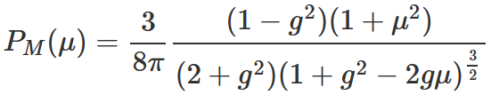
Phase functions
Rayleigh phase function (mu is the cosine between view dir and light dir)
Mie phase function (mu is the cosine between view dir and light dir, g a.k.a. mean cosine controls anisotropy, e.g. 0.76)

Slide 10
Optical depth

Slide 11
References
Volume rendering
https://www.scratchapixel.com/lessons/advanced-rendering/volume-rendering-for-artists
Simulating sky
https://www.scratchapixel.com/lessons/procedural-generation-virtual-worlds/simulating-sky
Atmospheric scattering
https://www.alanzucconi.com/2017/10/10/atmospheric-scattering-1/

